Slide 1

OODP Ⅰ
Object-Oriented Design Patterns
Lecturer : Dr.Tharaka Sankalpa

Slide 2
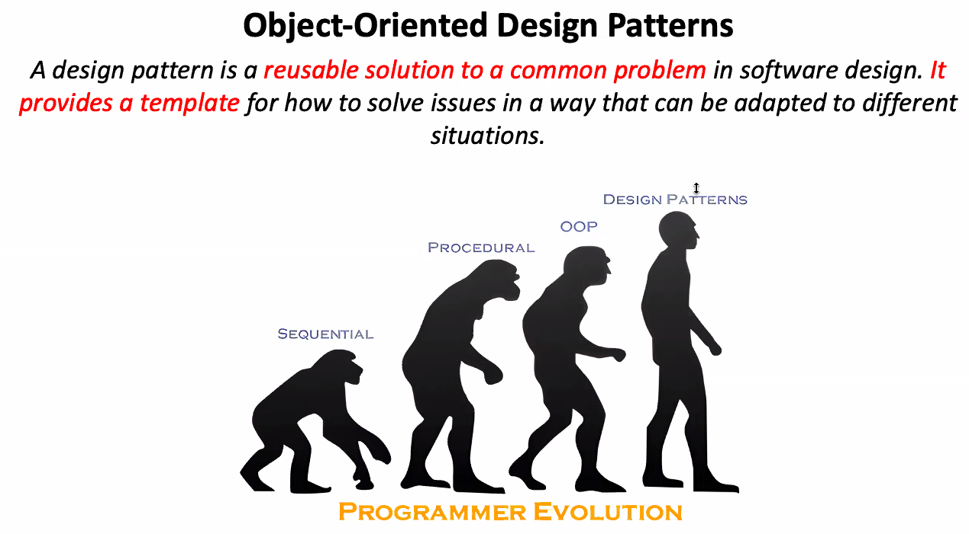
2024-07-28

Slide 3
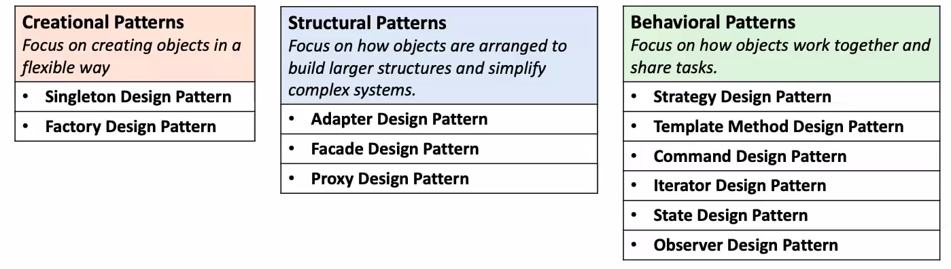

Slide 4
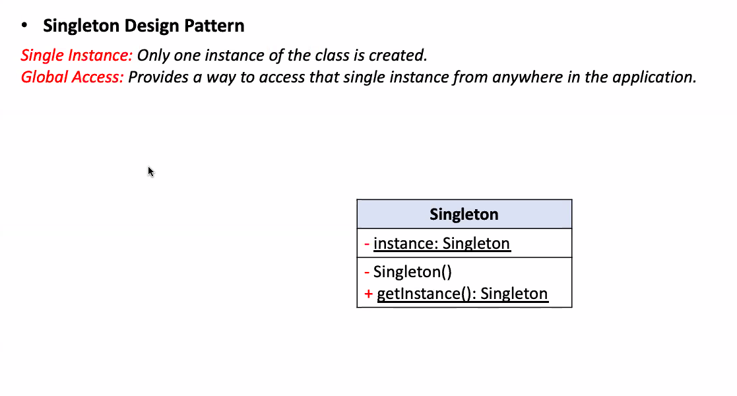

Slide 5
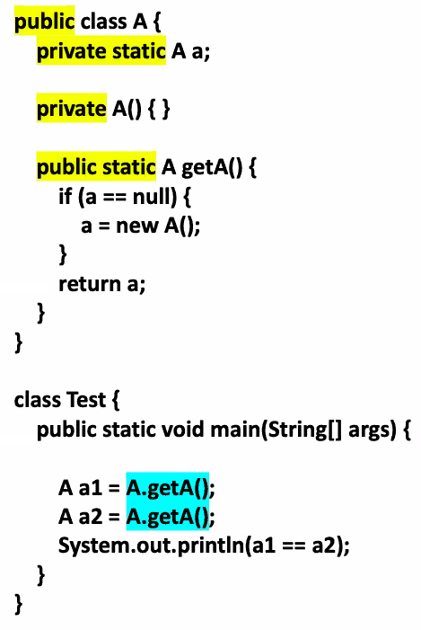
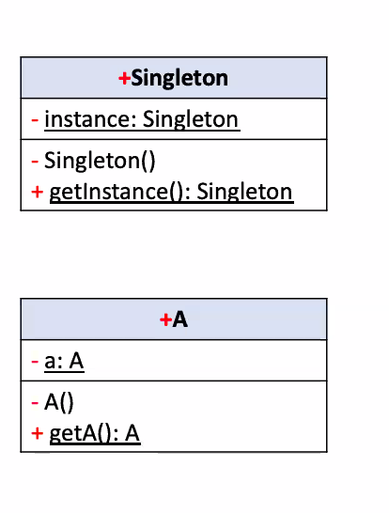

Slide 6
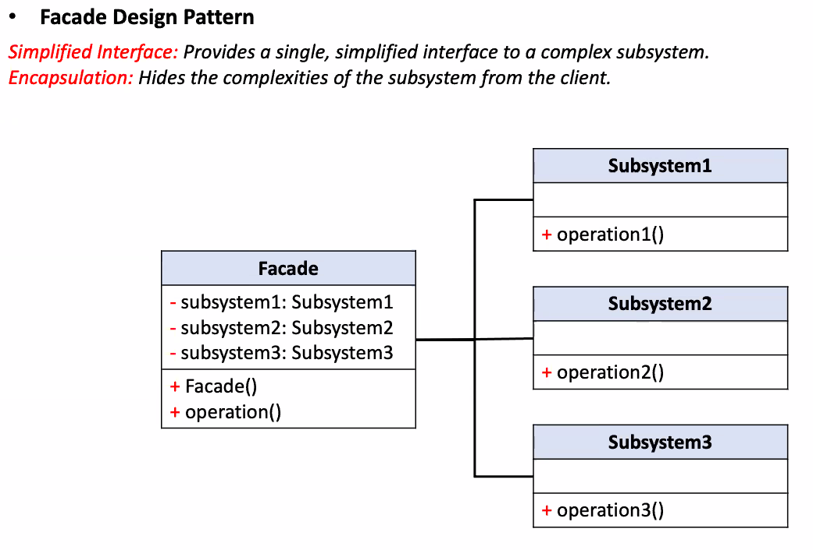

Slide 7
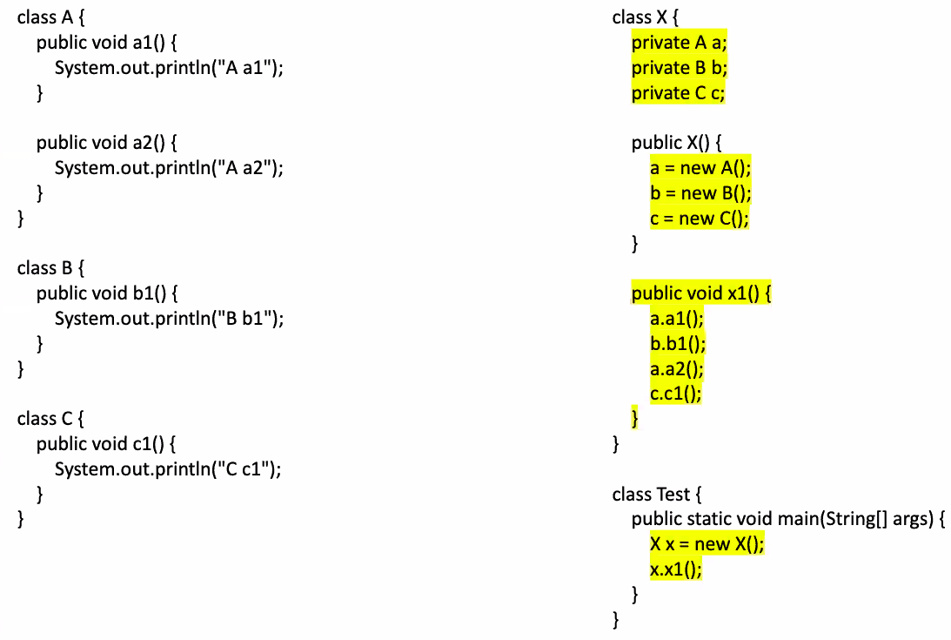

Slide 8
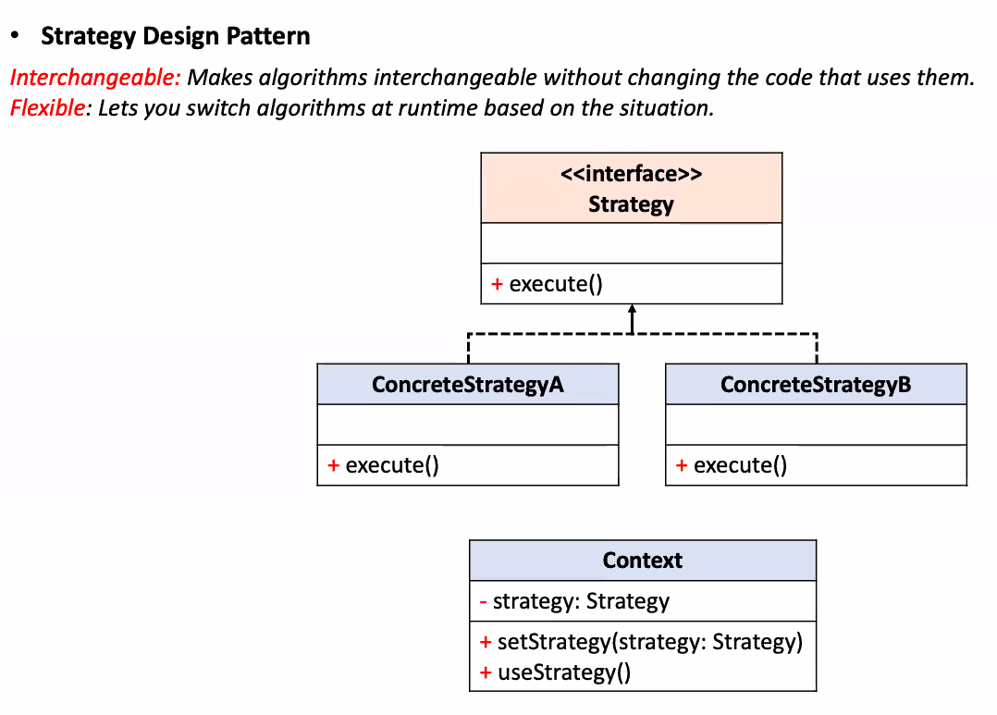

Slide 9
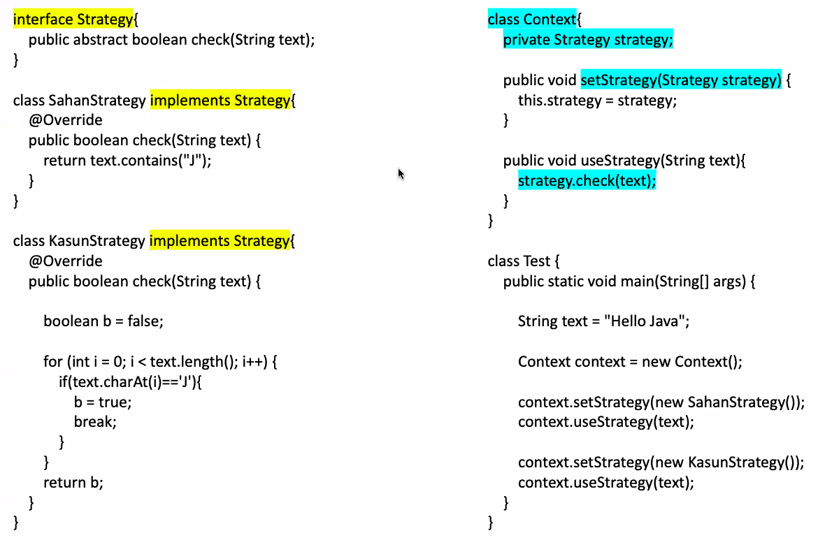

Slide 10
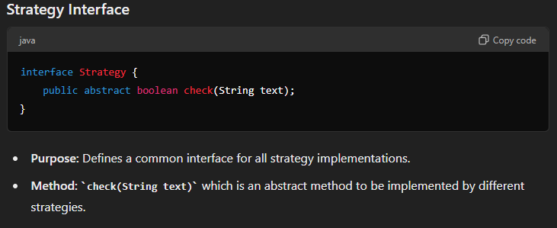
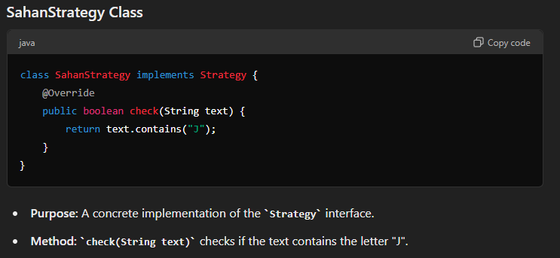

Slide 11
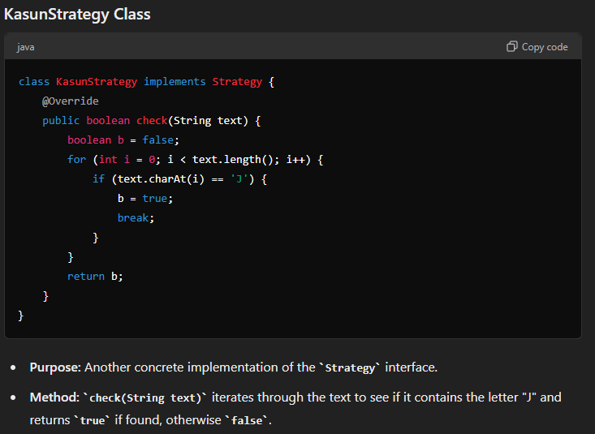

Slide 12
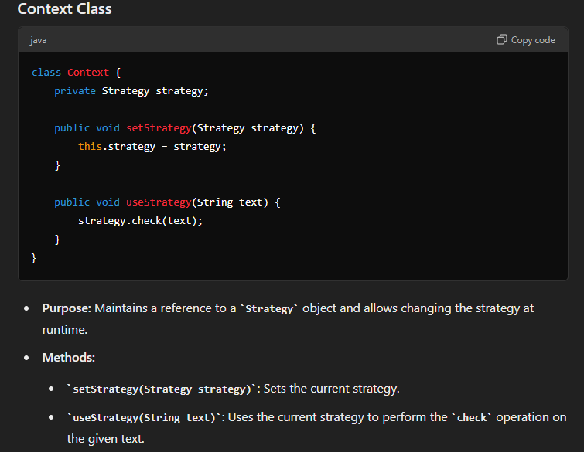

Slide 13
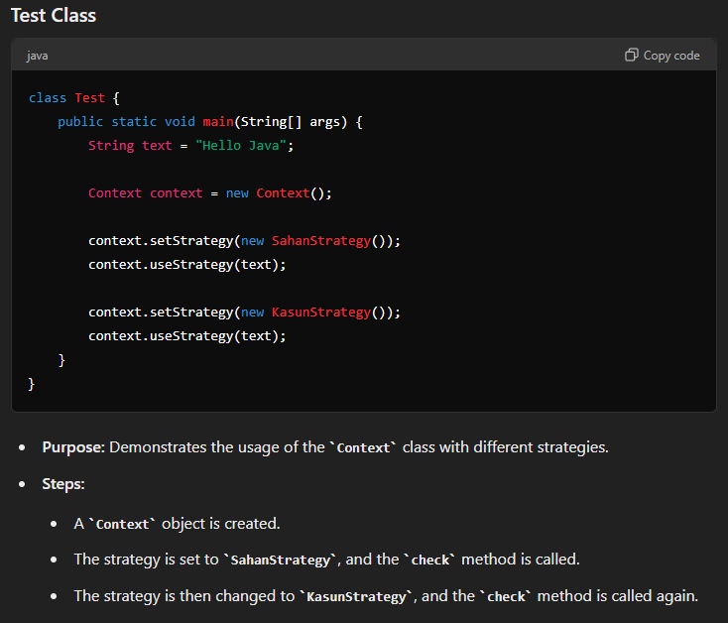

Slide 14
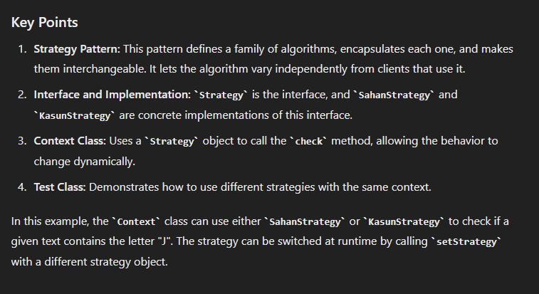

Slide 15
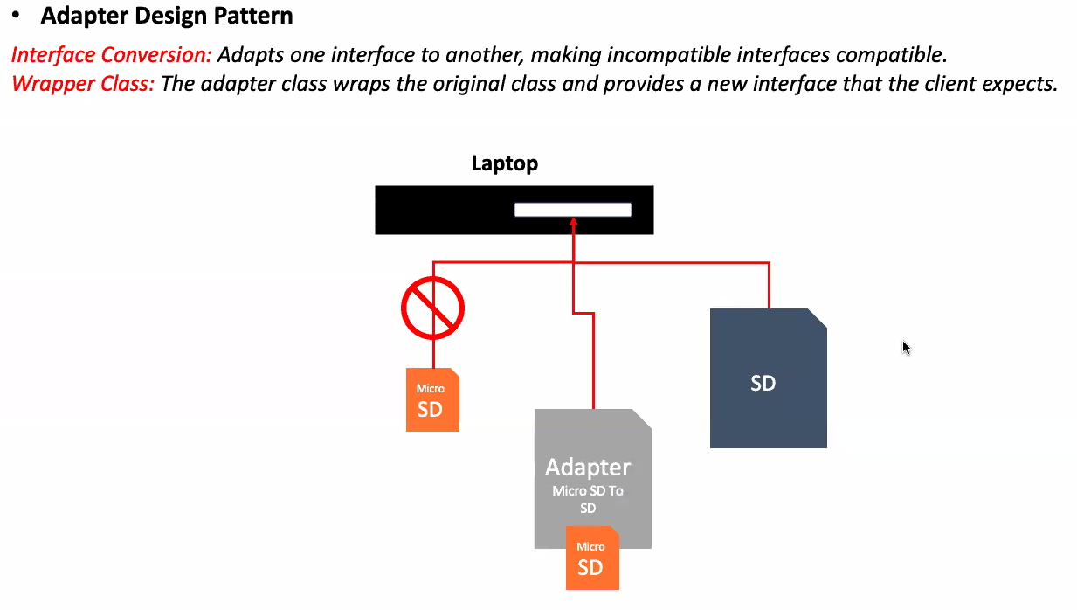

Slide 16
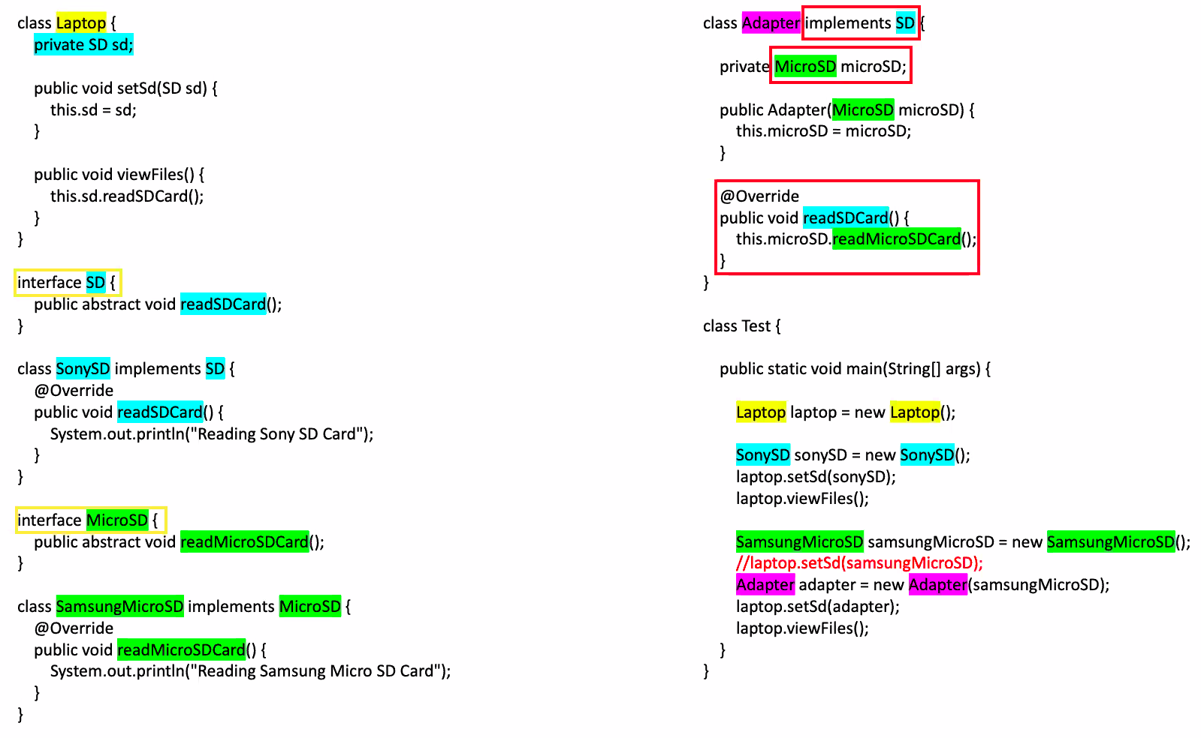

Slide 17
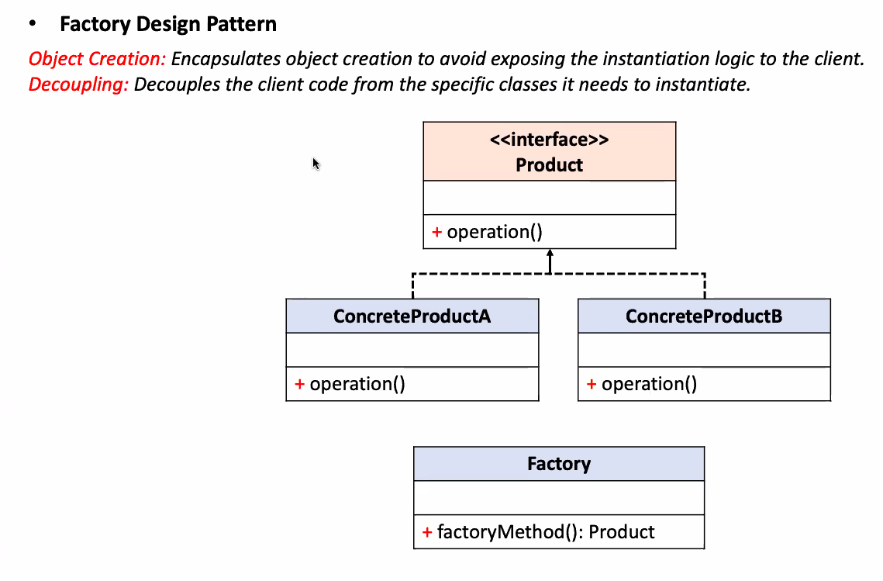
2024-07-29

Slide 18
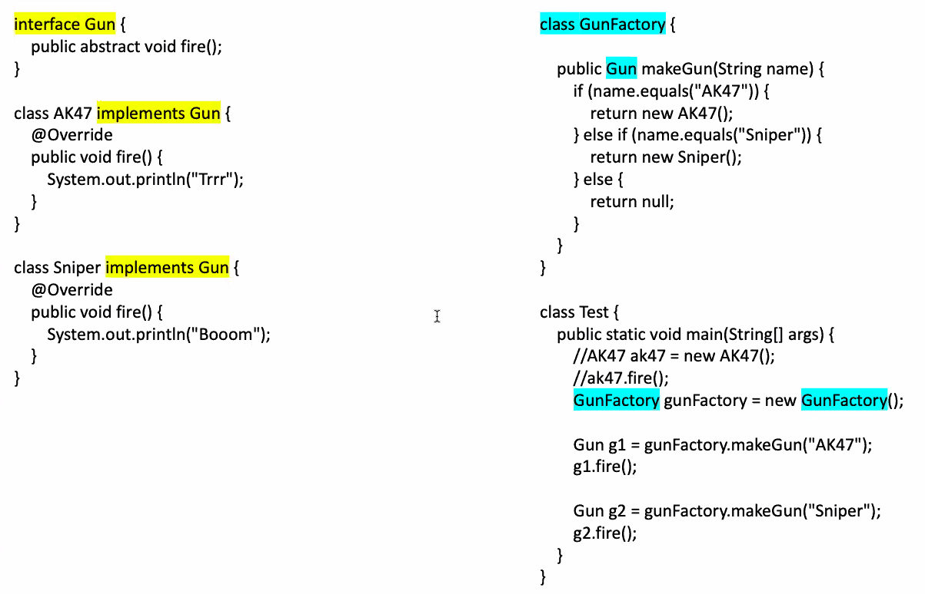
Notes:
Key Points:
Interface Gun: Defines a method fire(), which must be implemented by any class that implements this interface.
Class AK47: Implements the Gun interface and provides its own implementation of the fire() method, printing "Trrr".
Class Sniper: Implements the Gun interface and provides its own implementation of the fire() method, printing "Booom".
Class GunFactory: Contains a method makeGun(String name) that returns an instance of AK47 or Sniper based on the input string. If the input does not match either, it returns null.
Class Test: Demonstrates the usage of the GunFactory to create instances of Gun and invoke their fire() methods.
Explanation:
Interface Gun:
Declares an abstract method fire().
Class AK47:
Implements the Gun interface.
Overrides the fire() method to print "Trrr".
Class Sniper:
Implements the Gun interface.
Overrides the fire() method to print "Booom".
Class GunFactory:
Contains the method makeGun(String name) which returns a Gun object.
Based on the string name, it returns an instance of either AK47 or Sniper. If the name does not match, it returns null.
Class Test:
The main method demonstrates how to use the GunFactory to create Gun instances and call their fire() methods.
The commented-out lines show an alternative way to create and use AK47 directly.
Creates a GunFactory object.
Uses the factory to create AK47 and Sniper objects and calls their fire() methods.
This example illustrates the Factory Design Pattern, where the creation of objects is delegated to a factory class, promoting loose coupling and adherence to the Open/Closed Principle.

Slide 19
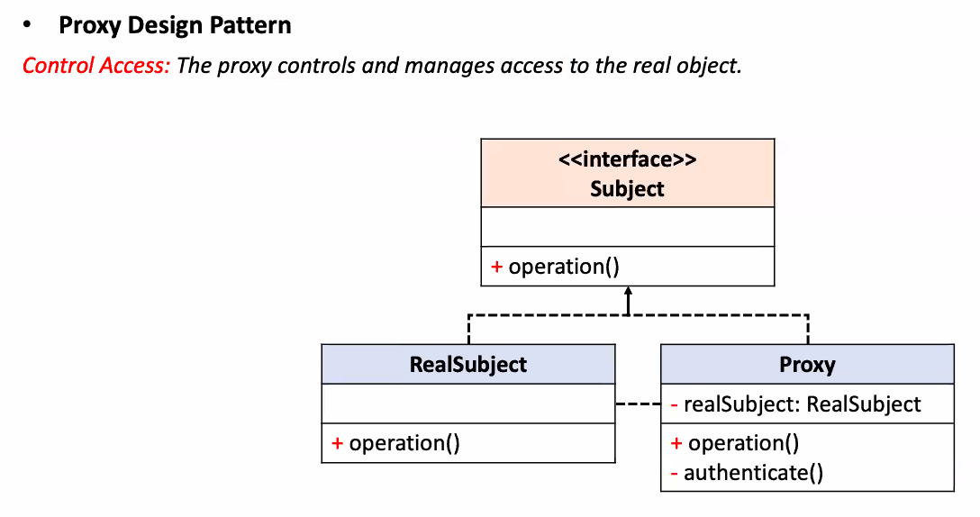
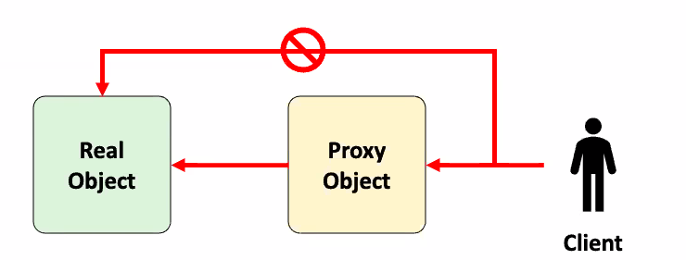

Slide 20
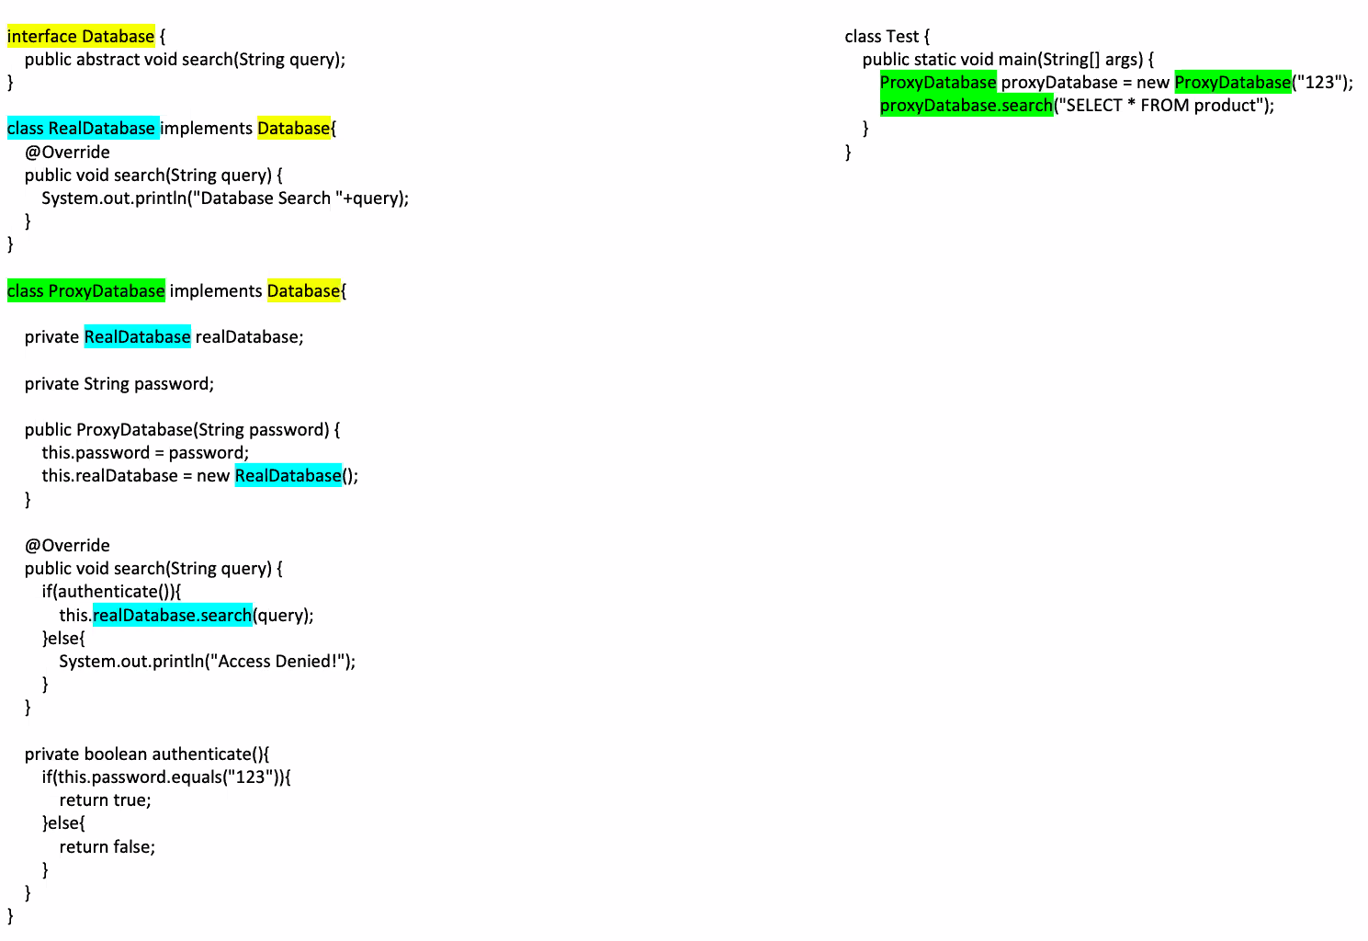
Notes:
Key Points:
Database Interface: Establishes a contract for database operations.
RealDatabase Class: Implements the actual database search functionality.
ProxyDatabase Class: Acts as a proxy, adding an authentication layer before accessing the real database.
Test Class: Demonstrates the usage of the proxy to perform a database search with authentication.

Slide 21
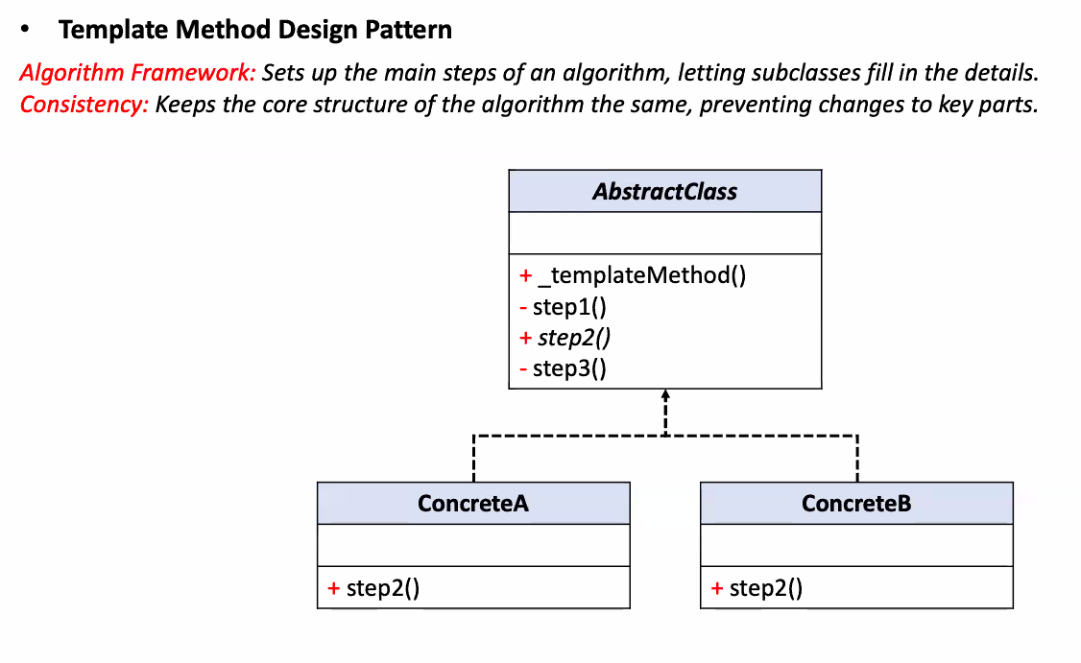

Slide 22
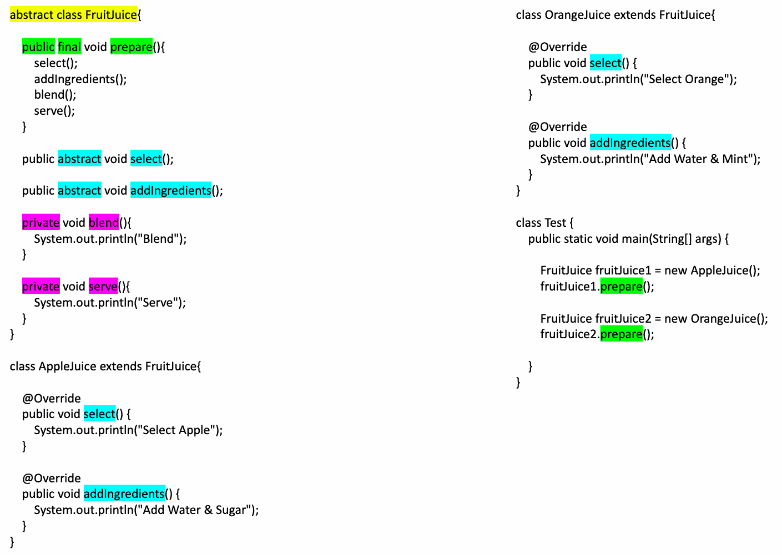

Slide 23
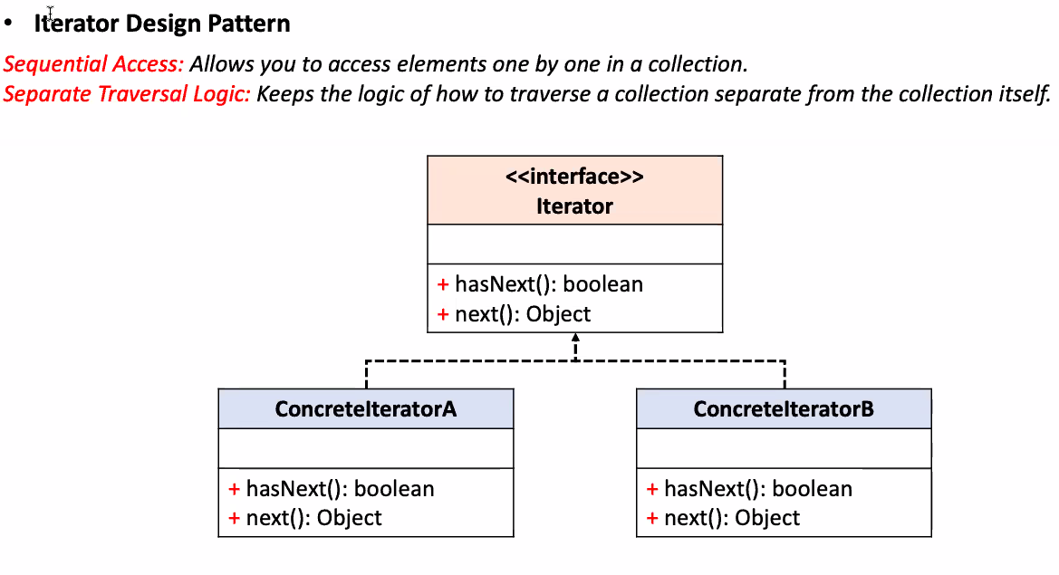

Slide 24
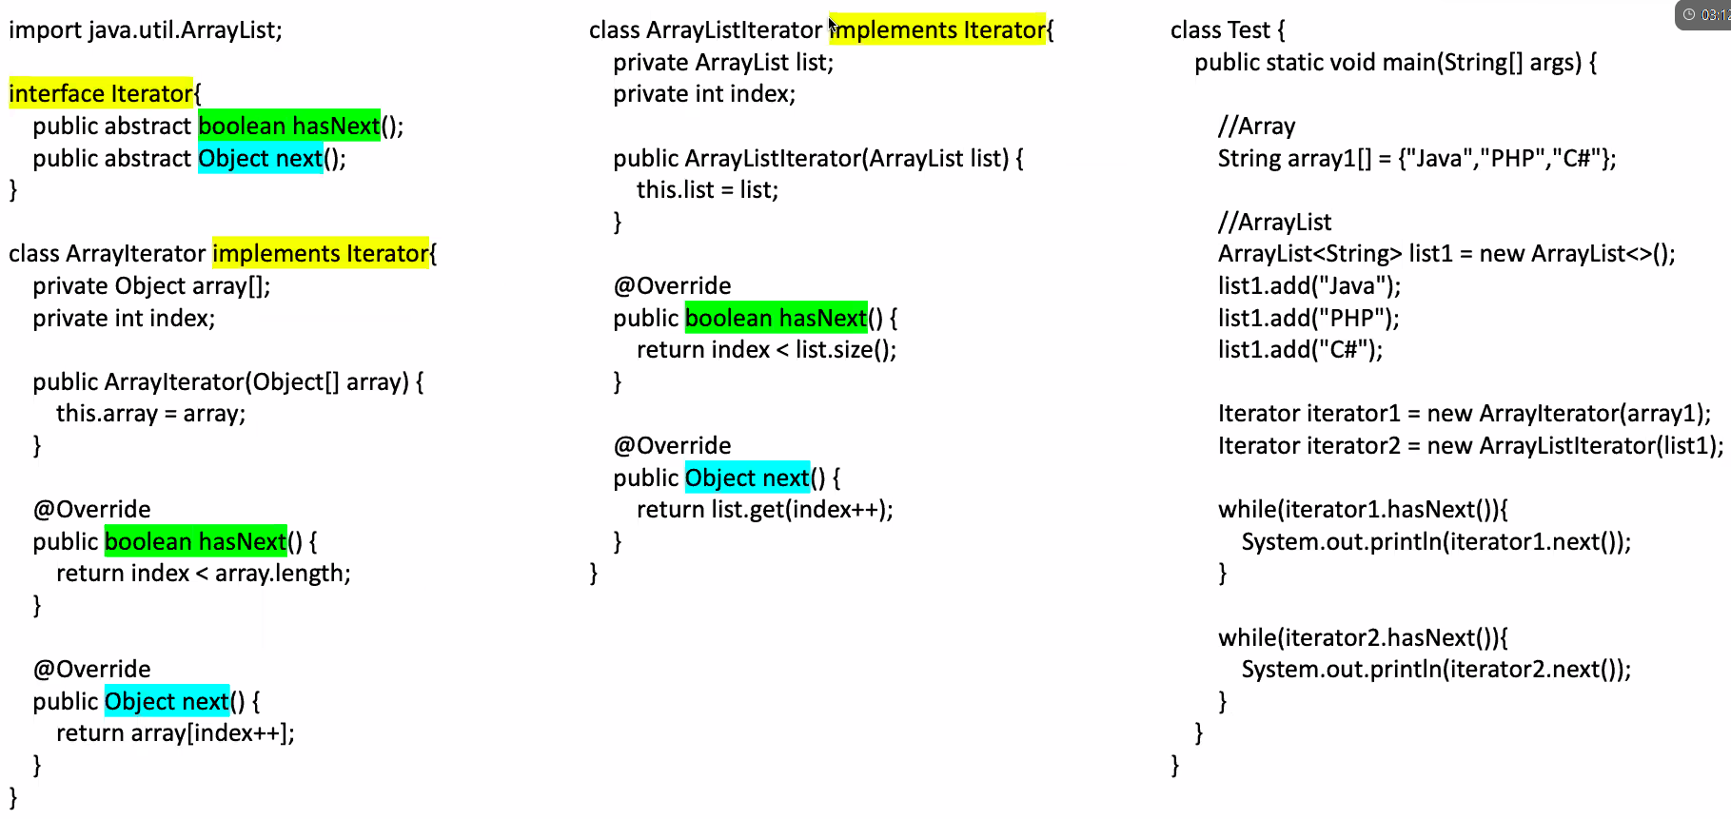
Notes:
Explanation
Interface Definition (Iterator Interface):
The Iterator interface defines two abstract methods: hasNext() and next().
hasNext() returns a boolean indicating whether there are more elements to iterate over.
next() returns the next element in the collection.
ArrayIterator Class:
This class implements the Iterator interface for an array.
It maintains an array and an index to keep track of the current position.
The hasNext() method checks if the current index is less than the length of the array.
The next() method returns the current element and increments the index.
ArrayListIterator Class:
This class implements the Iterator interface for an ArrayList.
It maintains an ArrayList and an index to keep track of the current position.
The hasNext() method checks if the current index is less than the size of the list.
The next() method returns the current element from the list and increments the index.
Test Class:
The main method creates an array and an ArrayList of strings.
It then creates an ArrayIterator for the array and an ArrayListIterator for the ArrayList.
Two while loops are used to iterate over the elements using the iterators, printing each element to the console.
This code demonstrates the use of the iterator pattern, allowing different types of collections (Array and ArrayList) to be iterated over using a common interface (Iterator).

Slide 25
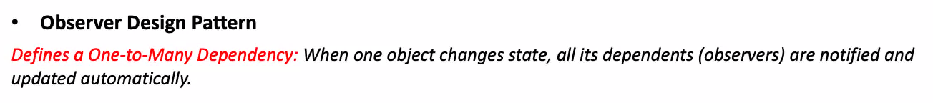
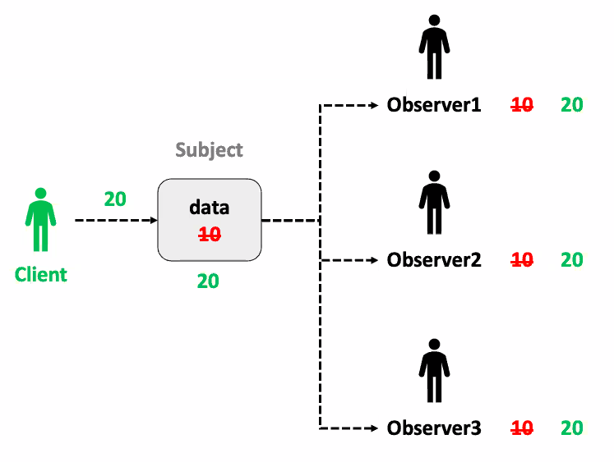
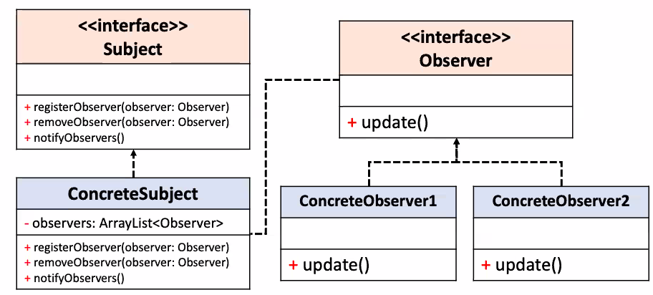
Notes:
Arrows nathiwa mark karana ewa thama Has-A relationships

Slide 26
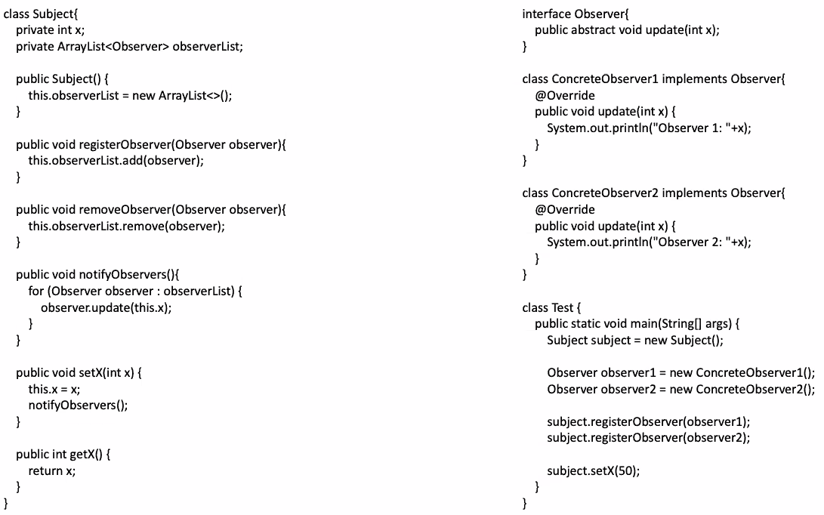
Notes:
1st method

Slide 27
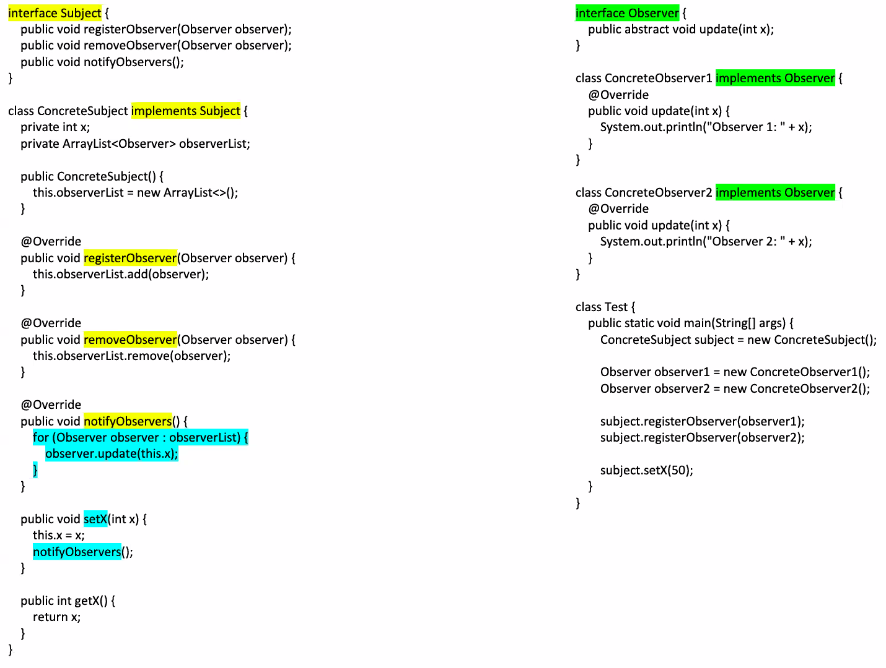
Notes:
2nd method
Explanation:
The Subject interface defines the methods that any subject must implement to allow observers to register, unregister, and be notified of changes.
The ConcreteSubject class implements the Subject interface, maintaining a list of observers and managing state changes.
The Observer interface defines the update method that observers must implement.
ConcreteObserver1 and ConcreteObserver2 are concrete implementations of the Observer interface, each providing a specific reaction to state changes.
The Test class sets up the subject and observers, demonstrating the observer pattern in action by changing the state of the subject and triggering updates to the observers.
This implementation of the Observer pattern allows for a decoupled way of handling state changes, where the subject and observers are loosely connected through the interfaces, enabling easy scalability and maintenance.

Slide 28
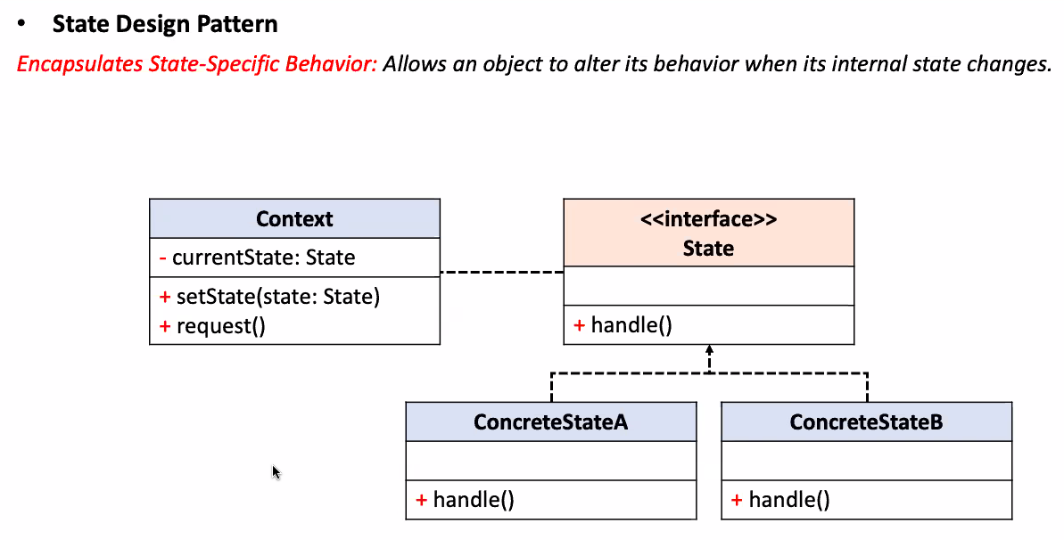
Notes:
Meka hariyata Strategy pattern eka wagemai

Slide 29
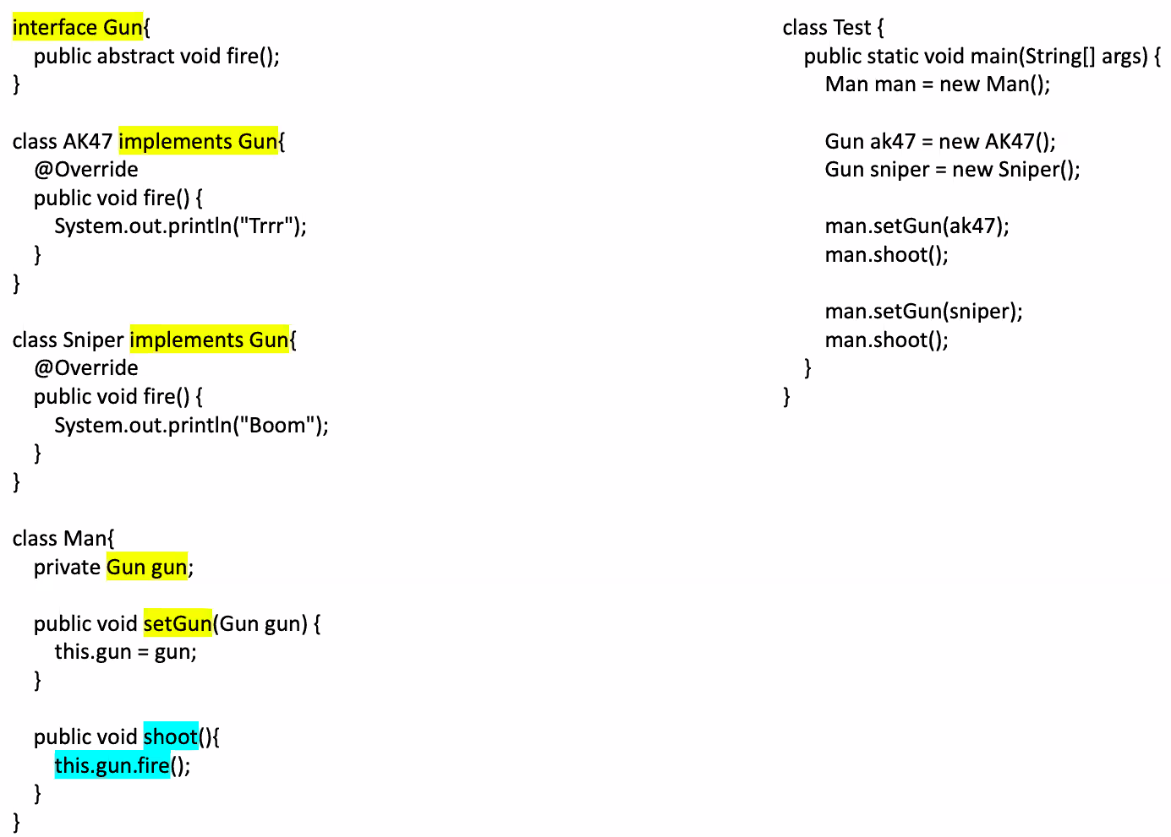
Notes:
Key Points and Explanation:
Interface Gun:
Defines a contract with a single method fire(). Any class implementing this interface must provide an implementation for this method.
Class AK47 and Sniper:
Both classes implement the Gun interface and provide specific implementations for the fire() method.
AK47 prints "Trrr" when fired, simulating the sound of an AK47.
Sniper prints "Boom" when fired, simulating the sound of a sniper rifle.
Class Man:
This class has a private field Gun gun, which can hold any object that implements the Gun interface.
The method setGun(Gun gun) allows setting this field to a specific Gun implementation.
The method shoot() calls the fire() method of the gun currently held by the Man.
Class Test (main method):
This is where the program is executed.
A Man object is created.
Two Gun objects (AK47 and Sniper) are created.
The Man is given the AK47 gun and shoots, which prints "Trrr".
The Man is then given the Sniper gun and shoots, which prints "Boom".
This demonstrates polymorphism, as the Man object can use different types of Gun objects interchangeably, depending on what is passed to it.
Summary:
The code showcases object-oriented concepts like interfaces, polymorphism, and encapsulation. The Man class can shoot with any Gun implementation without knowing the specific type of gun, highlighting the flexibility of using interfaces.

Slide 30
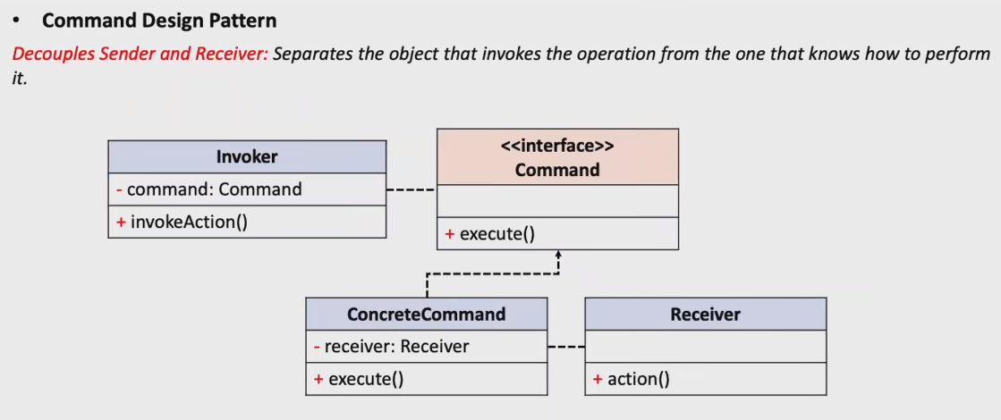

Slide 31
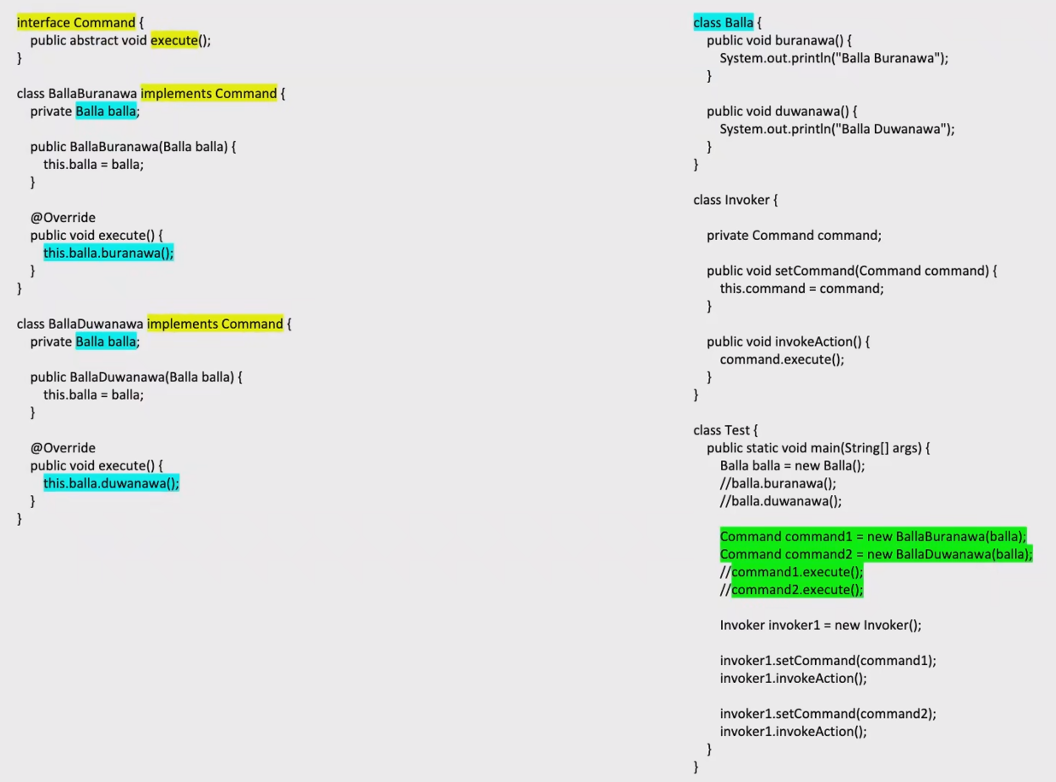
Notes:
Key Points:
Command Interface:
The Command interface defines a single method execute(). This is the contract that all command classes must follow, ensuring that they provide a way to execute a specific action.
Concrete Command Classes (BallaBuranawa and BallaDuwanawa):
These classes implement the Command interface and override the execute() method to perform a specific action (buranawa() and duwanawa() respectively) on the Balla object.
Each command class encapsulates a request as an object, allowing for parameterization of clients with different requests, queuing of requests, and logging them.
Receiver Class (Balla):
This class contains the actual methods (buranawa() and duwanawa()) that perform the work.
The methods simply print a message to the console.
Invoker Class:
The Invoker class is responsible for triggering the command. It holds a reference to a Command object and can invoke the execute() method on this command, which in turn triggers the action in the Receiver class.
Client Code (Test Class):
In the Test class, a Balla object is created, and two Command objects (BallaBuranawa and BallaDuwanawa) are instantiated with this Balla object.
The Invoker class is then used to execute the commands by calling invokeAction(). The invoker executes the current command that has been set.
Summary:
This code demonstrates the Command Design Pattern, which encapsulates a request as an object, allowing you to parameterize clients with different requests, queue or log requests, and support undoable operations. The pattern is useful in situations where you need to issue requests to objects without knowing exactly what operation will be performed or the receiver of the request.

